Slide 1
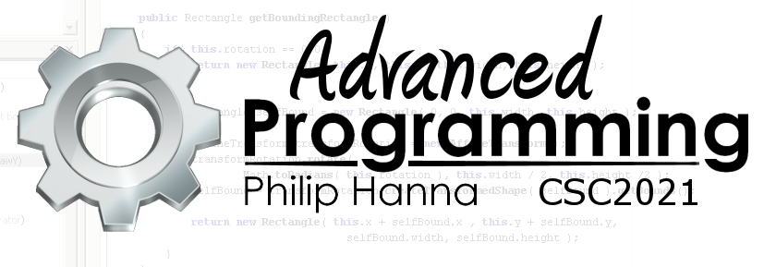
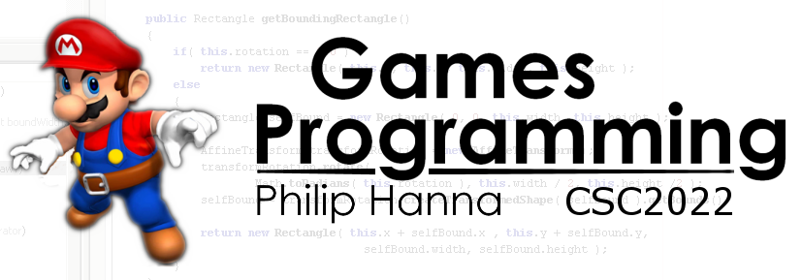
Sound
The importance of sound and music within games

Slide 2
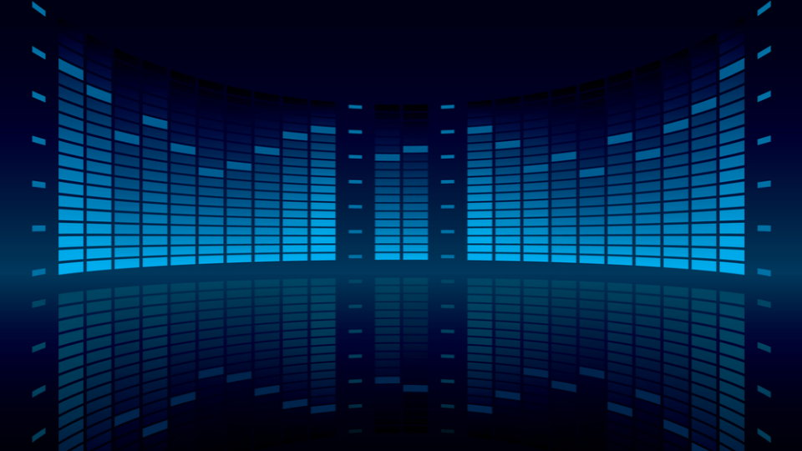
Using sound in games

Slide 3


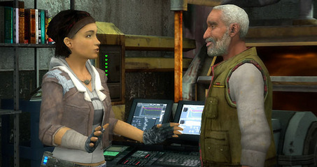

The use of sound within games includes:
Music - establishing scene mood, e.g. uplifting, urgent, peaceful, etc.
Sound effects - dependent sounds tied to in-game events, e.g. collecting power-ups, jumping, etc.
Dialog – recorded/generated speech used within cut-scenes or in-game (improving realism, emersion, etc.).

Slide 4
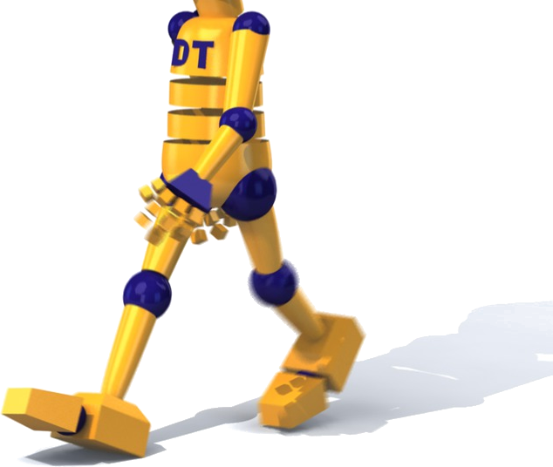
Sound plays a deceptively important role in setting the mood and determining how immersive the game is.
For example, movement without footfall sounds will reduce the believability (consciously, or not, the player will feel movement is not ‘right’).

Slide 5
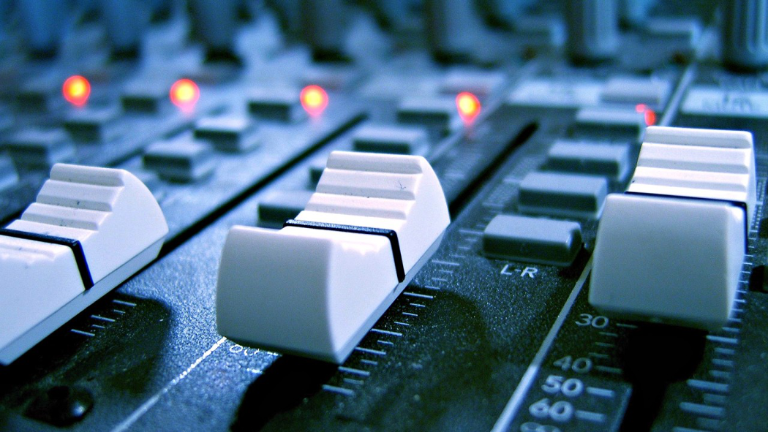
Managing sound playback

Slide 6
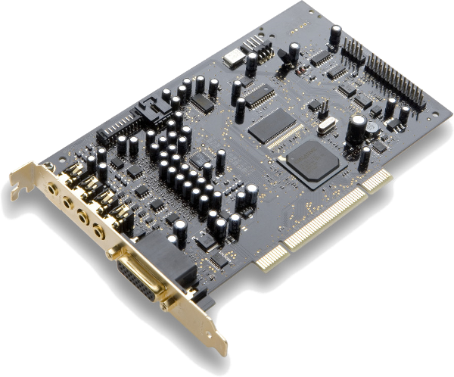
: Output Channels
Sound hardware supports a number of audio output channels (simultaneous sounds) that can be combined together in different ways.

Slide 7
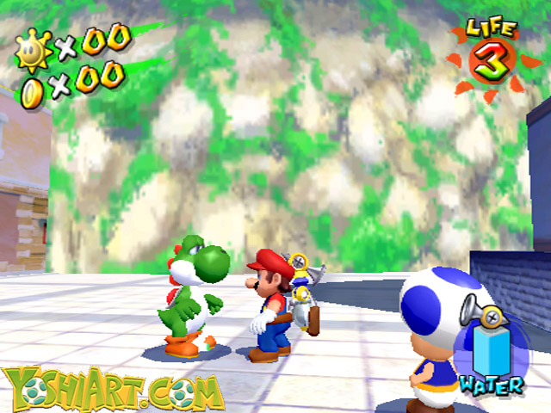
: Building a Soundscape
Playback of sound producing events can be combined with appropriate background music to create the soundscape.
Background music
People talking
Water sounds
Foot falls

Slide 8
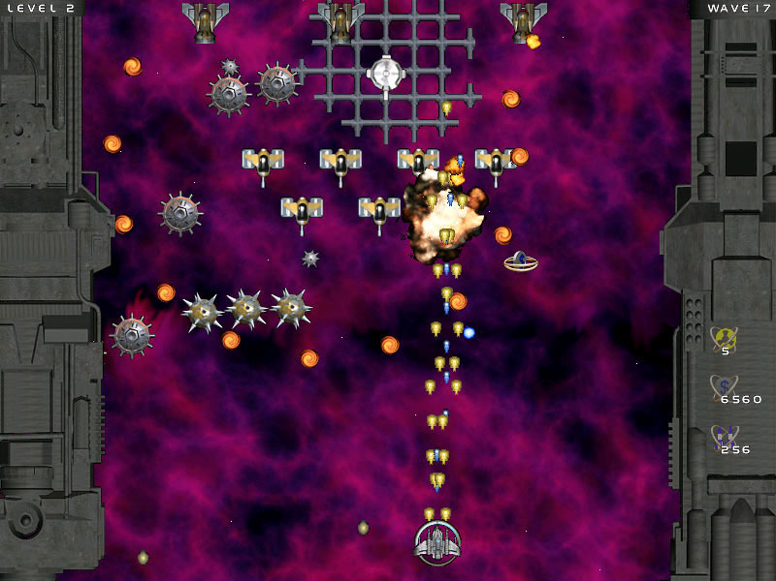
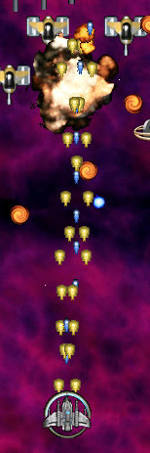
: Building a Soundscape
If every explosion creates a sound then a noisy mess of sounds may result.

Slide 9
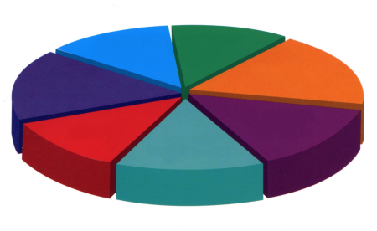
: Managing Playback
Total 32 channels
One option is to develop a sound manager that allocates a maximum number of sound channels to each category of sound.
When the playback limit has been reached in a class the longest playing sound in that class can be cut short to make way for the new sound.
Projectile hits
(max 10 channels)
Explosions
(max 6 channels)

Slide 10

Key takeaways:
Audio is one of the more important elements within a game for establishing the mood and improving game immersion.
From a coding perspective audio is relatively straightforward, although management is sometimes needed.

